Slide 1
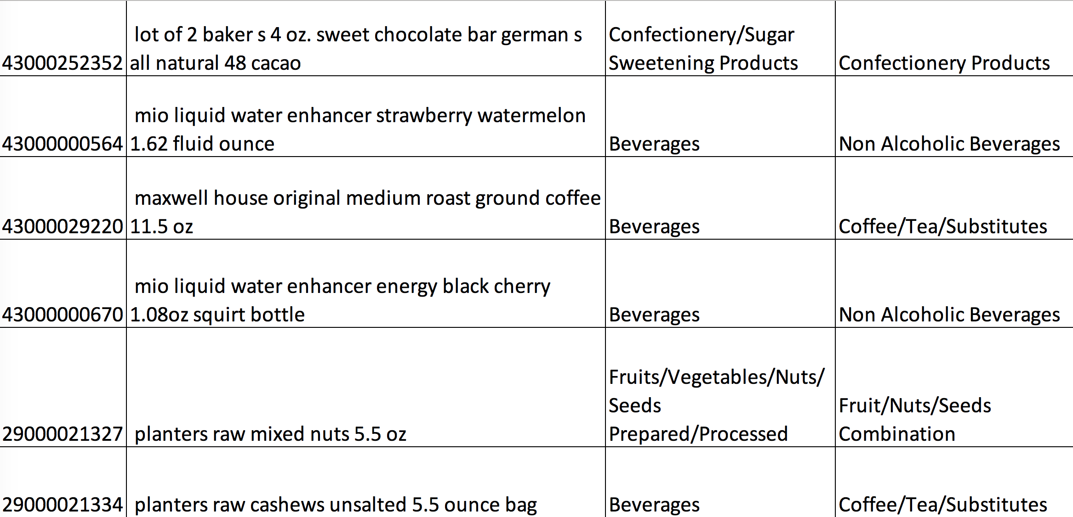
Categorizing E-Commerce Products by Natural Language Processing Method
Chang Zhang
2019/08/26

Slide 2
Executive Summary
Objective:
Develop a code framework to scrape UPC codes from webpages and automate product categorization process. The results can help human l
Steps taken to achieve the objective:
1. Scraped 1,200 UPC codes from www.barcodelookup.com (website has a max query limit per day) .
2. Cleaned data and wrangled data into a structured .csv format.
3. Grouped UPC codes according to their brands, dimensions, size, color, etc.
4. Categorized UPC codes into family category and class category of GS1 codes using Bag-of-Words (BOW) doc2vec approach.
5. Evaluated model results by manually checking the categorization outcome.
Results:
Successfully developed a code framework to achieve the process described above.
Categorization accuracy (based on a sample of 101 items, checked by human):
- Family category (16 categories): 92.1%
- Class category (109 sub categories): 86.1%

Slide 3
Outline
1 Webpage Scraping
2 Data Cleaning and Data Structuralization
3 Product Categorization based on doc2vec Approach
4 Model Evaluation
5 Conclusion and Recommendation

Slide 4
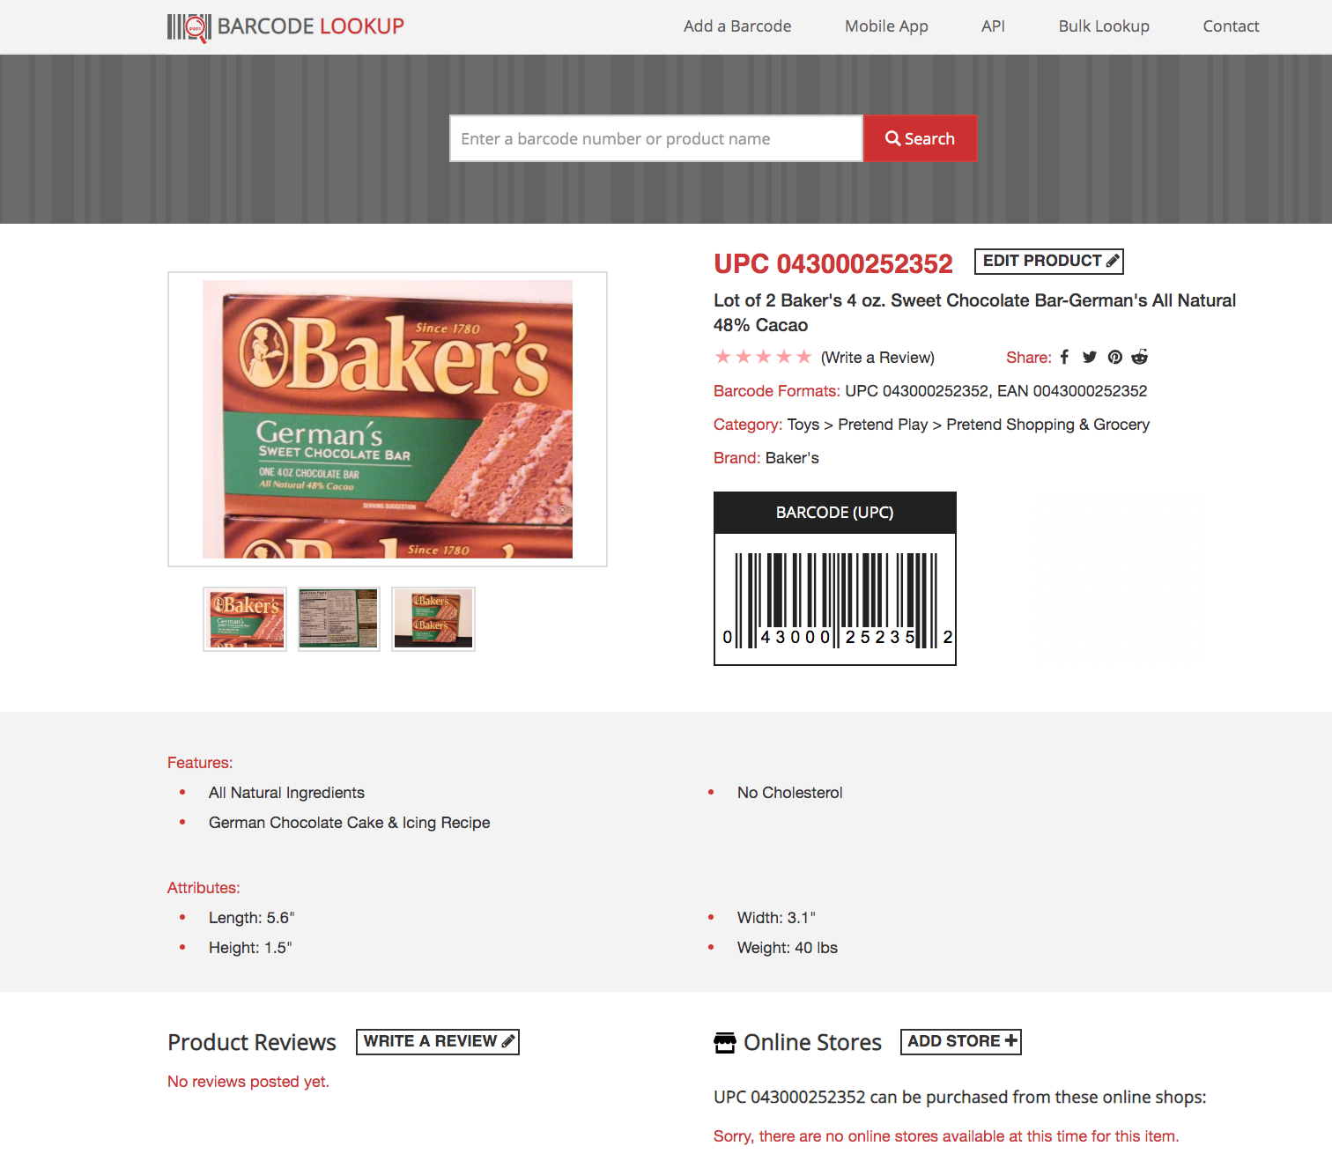
1 Webpage Scraping
I firstly used beautifulsoup (A python library) to scrape important information associated with each UPC code on barcodelookup website.
UPC code: 043000252352
Title: Lot of 2 Baker’s 4 oz. Sweet Chocolate Bar-German’s All Natural 48% Cacao
Features: All natural ingredients, no cholesterol, German chocolate cake and icing recipe.
Attributes: Length 5.6”, Width 3.1”,
Height 1.5”, Weight 40lbs
https://www.barcodelookup.com/

Slide 5
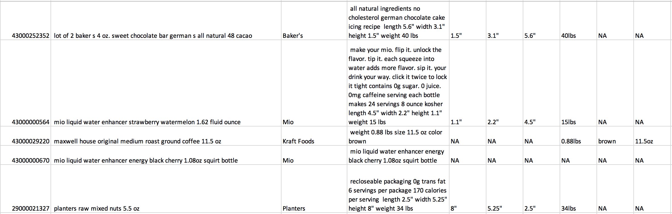
2 Data Cleaning and Data Structuralization
Title: Lot of 2 Baker’s 4 oz. Sweet Chocolate Bar-German’s All Natural 48% Cacao
Attributes: Length 5.6”, Width 3.1”,
Height 1.5”, Weight 40lbs
Cleaning text by removing special chars and punctuations
Key word matching
UPC code
Product
Name
Brand
Description
Dimensions
Then I structuralize the scraped text into a structured .csv file with each column containing one attribute.

Slide 6
3 Product Categorizing based on doc2vec Approach
BOW doc2vec
red green apple pepper juice salad
green apple juice ( 0, 1, 1, 0, 1, 0)
apple juice ( 0, 0, 1, 0, 1, 0)
apple salad ( 0, 0, 0, 0, 0, 1)
UPC
More similar
GS1
Less similar
GS1
- I converted each UPC and GS1 code into vectors V_{UPC} and V_{GS1} that represents the occurrence of its words (BOW).
- Then I check the similarity between V_{UPC} and each V_{GS1}
Similarity = cos(V_{UPC}, V_{GS1})
- The GS1 code that has the highest similarity determines the category of UPC code.
Red apple juice: -> beverage, ready to drink

Slide 7
3 Product Categorizing based on doc2vec Approach
Sample results:
UPC title family class

Slide 8
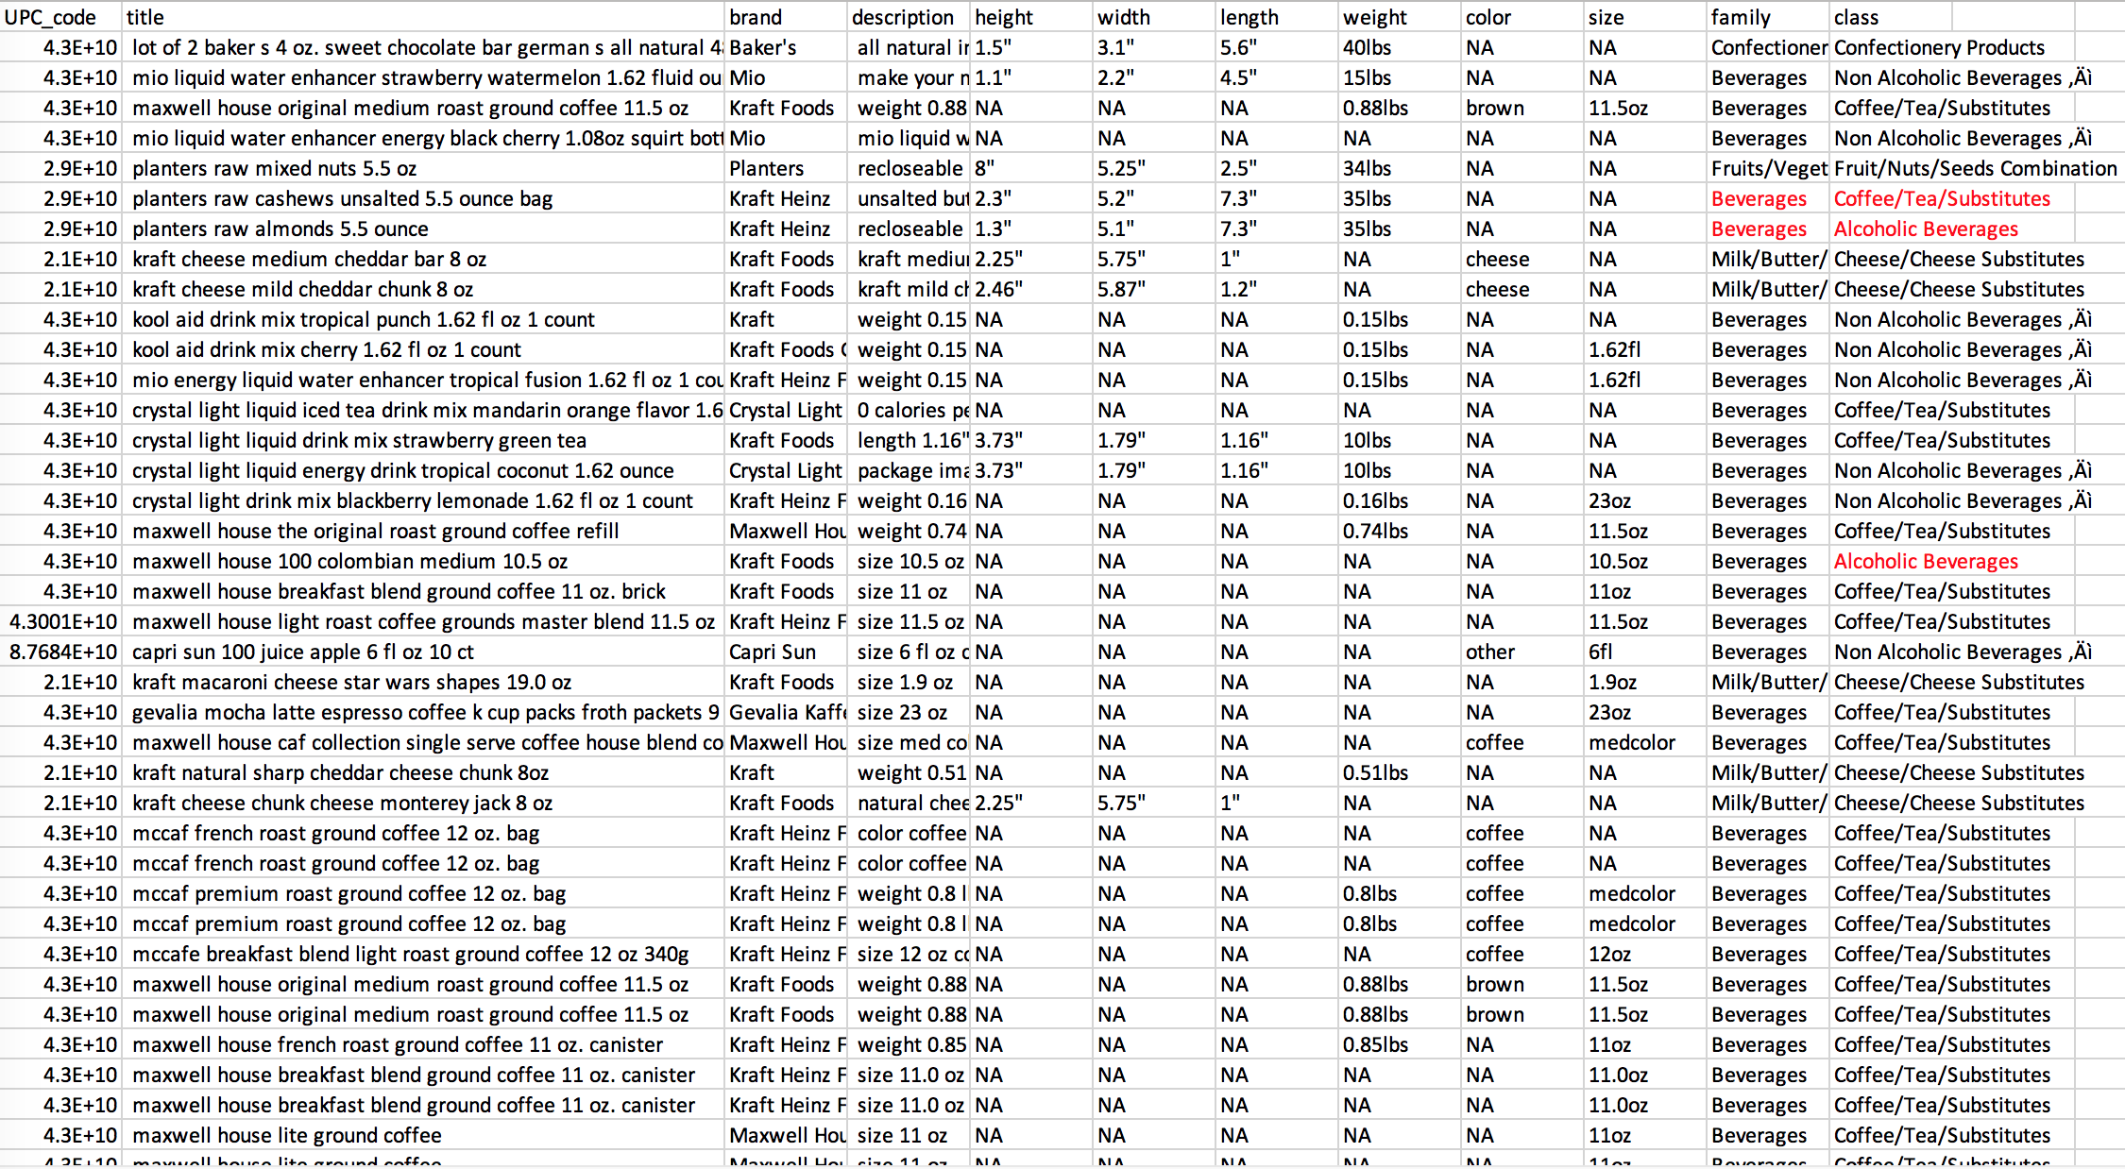
4 Model Evaluation
I manually checked categorization results of 101 data points. The mis-categorized UPC codes are marked red in the table on the right. (the manually checked table is in the package.)
Based on the sample, the categorization accuracy on family category is 92.1%; and the categorization accuracy on class category is 86.1%.

Slide 9
5 Conclusions and Recommendations
We have successfully developed a code framework to scrape UPC codes from webpages and , which can significantly reduce human work.
As we are dealing with a large dataset (>30 MB), it takes a long time to finish the code on a personal computer. Thus, I recommend take the following steps to speed up the process:
1. Label part of the codes manually and then train the model on the labeled data to improve accuracy.
2. Build an image classifier and use images to assist categorization process.
3. Purchase web API from www.upcitemdb.com to enable unlimited fast UPC code scraping.
4. Purchase AWS cloud computing service to speed up the categorization process.

